Slide 1
The Elsevier Foundation
Partnering for inclusive health and research
April 2024

Slide 2
Who we are
The Elsevier Foundation is a corporate not-for-profit 501(c)(3), funded by Elsevier, a global information analytics business specialized in science and health.
Since 2005, the Elsevier Foundation provides grants to knowledge-centered institutions around the world.
The Elsevier Foundation champions inclusive health and research through partnerships that incubate new approaches, highlight inequities and catalyze change toward the UN Sustainable Development Goals. By leveraging Elsevier’s funding, networks and unique insights in content, data and analytics, the Elsevier Foundation expands its impact in health, inclusion and diversity, and climate action.

Slide 3
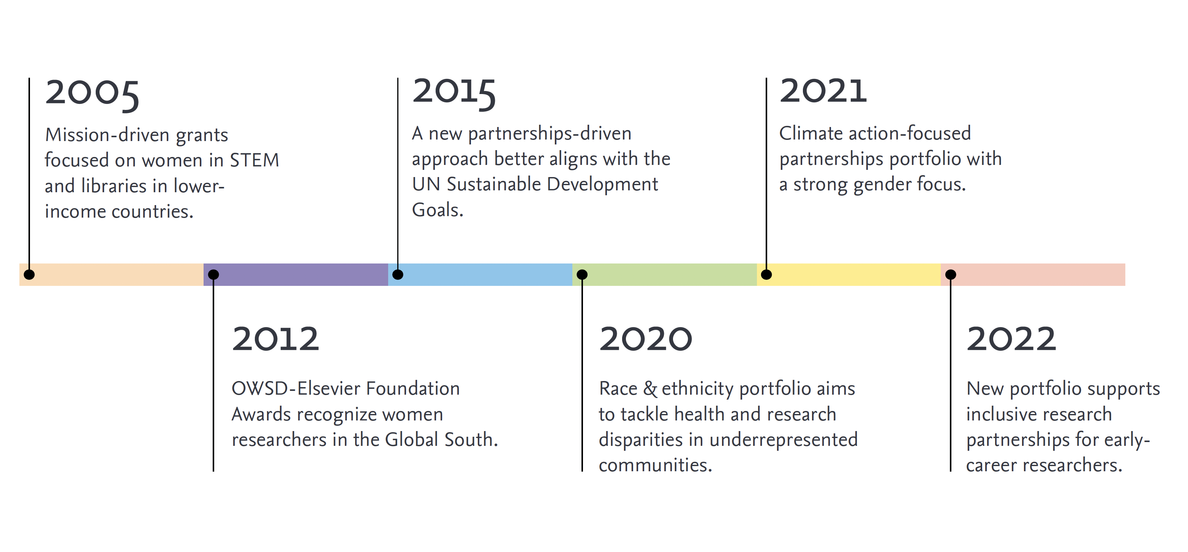
Who we are | Our history

Slide 4
What we do | Our impact
19
YEARS
70+ COUNTRIES
100+
PARTNERS
15+
MILLION USD
“I’ve always wanted to do something to make the world better. This Award will help me get exposure and create more opportunities for my research.”
Marian Asantewah Nkasah 2021 OWSD-Elsevier Foundation Women in Science Award winner, Ghana
Notes:
82 past programs
(44 libraries
39 new scholars)
20 since partnerships

Slide 5
What we do | Our programs
Inclusive Research The future of science requires a robust and diverse workforce drawn from all corners of society. Our programs advance women in science, encourage underserved youth to choose STEM careers, and widen access to academic knowledge for scientists in developing countries.
Inclusive Health Information technology can significantly advance the delivery of healthcare in vulnerable communities. Our partnerships support organizations working to improve health outcomes in underserved communities through the innovative use of health information.
Currently: 20+ partnerships in 10+ countries

Slide 6
How we work | Our team
On a day-to-day basis, the Elsevier Foundation is run by a small core team consists of an Executive Director, Partnerships Director, Coordinator and Communications Director.
The team receives support from a Treasurer and Legal Counsel.
In addition to annual programmatic funding, Elsevier provides funding to cover the administrative costs of running the Foundation and in-kind support through marketing, media outreach, data science expertise, analytics and volunteer support as needed from throughout the company.

Slide 7
How we work | Our Board
The Elsevier Foundation is governed by its Board which is comprised of 5 external and 6 internal (or ex-officio) members representing Elsevier – the company and funding partner. Members serve 3-year renewable terms.
The Elsevier Foundation Board meets biannually to provide strategic guidance for the Foundation’s programming and governance. Throughout the year, Board members also provide expertise and advice around new partnership development opportunities.
In addition, the Foundation team also regularly draws on the technical insights of a number of Elsevier advisors on areas such as data science, health informatics, nursing education and inclusion and diversity.

Slide 8
Inclusive Research
The future of science requires a robust and diverse workforce drawn from all corners of society. Our partnerships support equity in research across gender, race & ethnicity, and the global South.
Click on the pictures in the next slides to know more about each program

Slide 9
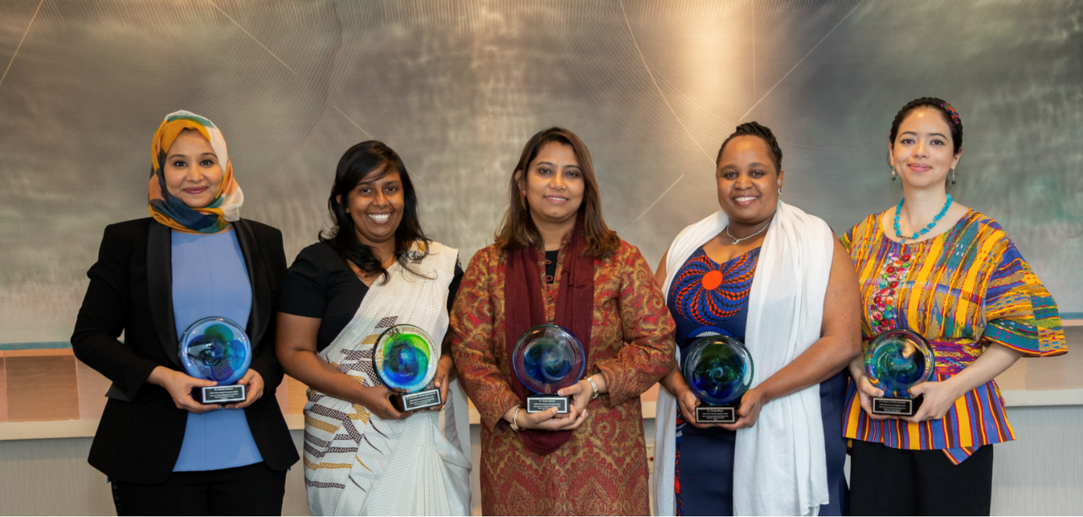
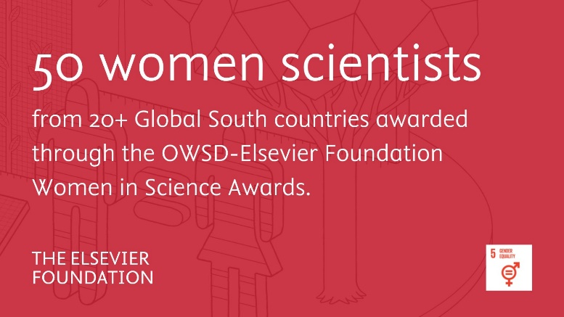
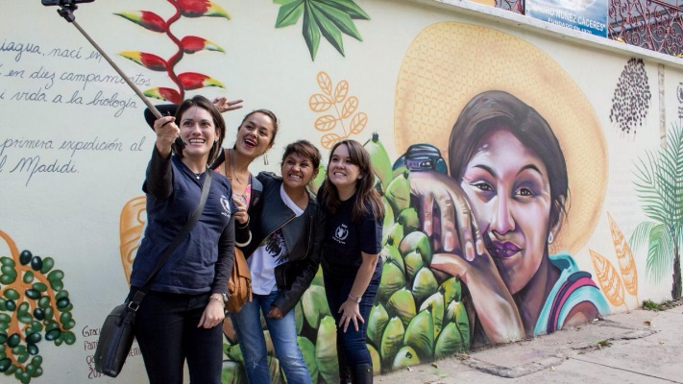
Partnerships | Women in Science Awards
Since 2013, helping elevate the careers of women researchers in low- and middle-income countries.
In 2024, contributions to research that tackles water security.
The prize also acknowledges the scientists’ commitment to leadership, mentoring and engagement within their communities.
Increases the researchers’ international visibility and networks.
Notes:
Just announced in February, it’s our flagship program.
Visibility
Networks
Visits to labs, national academies, embassies

Slide 10
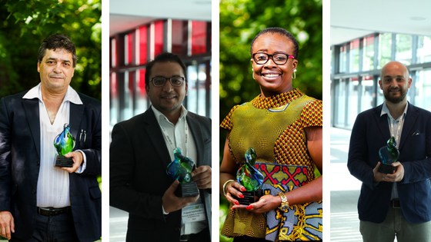
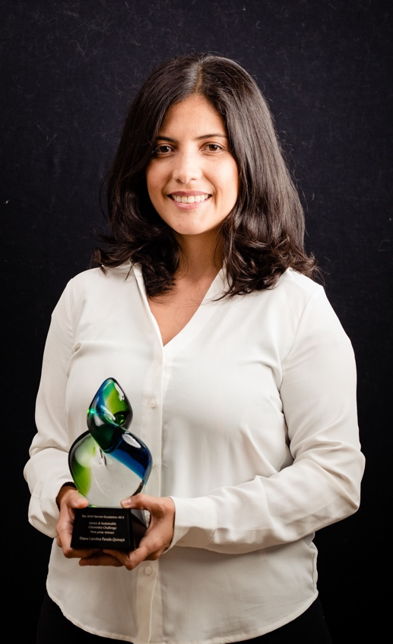
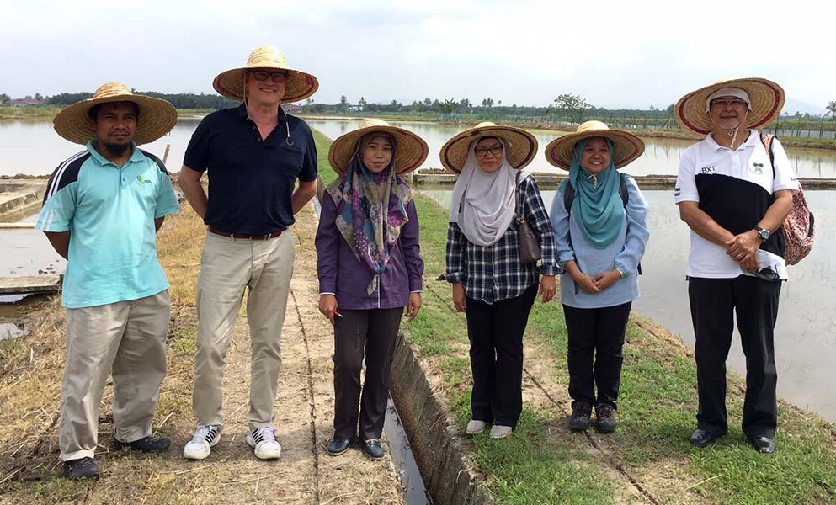
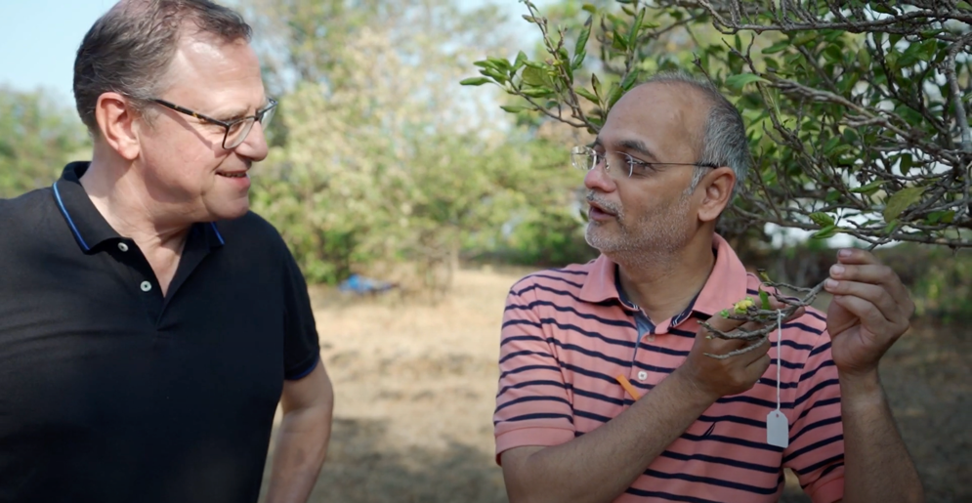
Partnerships | Chemistry for Climate Action Challenge
Awards projects that use green and sustainable chemistry solutions to tackle some of the Global South’s greatest challenges
Since 2017, contributions to research that tackles climate change.
Collaboration with Elsevier Chemistry journals portfolio
Awarded at the Elsevier Green & Sustainable Chemistry Conference each year, it increases the researchers’ international visibility.

Slide 11
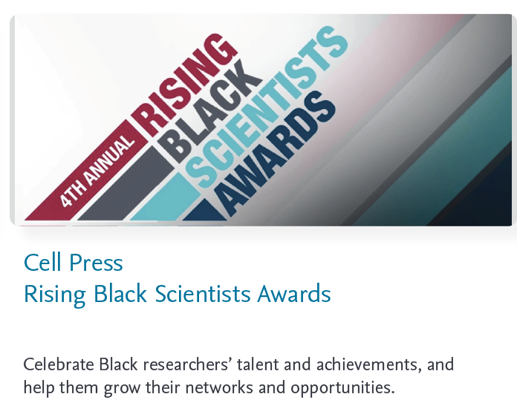
Partnerships | Prizes for underserved researchers in the US

Slide 12
Partnerships | Supporting early-career researchers (1)

Slide 13
Partnerships | Supporting early-career researchers (2)

Slide 14
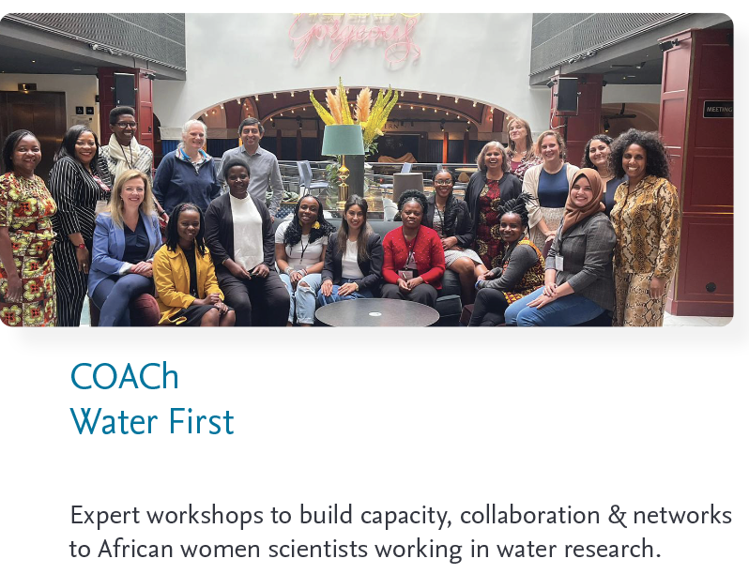
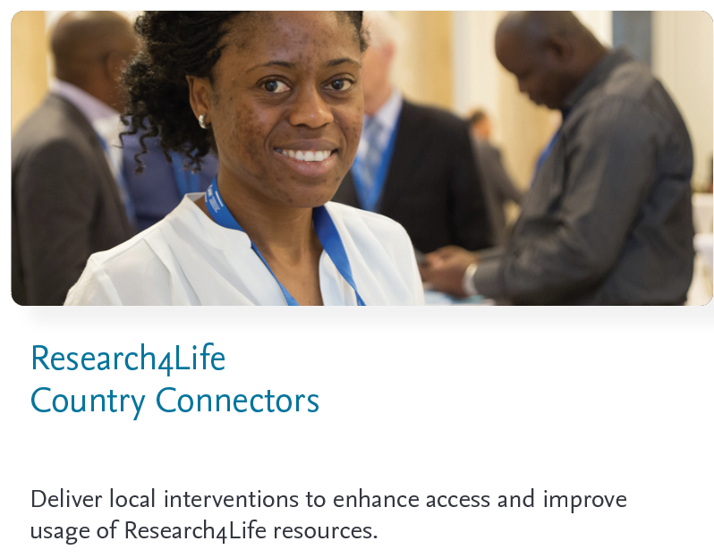
Partnerships | Research in the global South

Slide 15
Inclusive Health
Our partnerships support organizations working to improve health outcomes in underserved communities around the world, advancing the delivery of health equity for vulnerable populations.
Click on the pictures in the next slides to know more about each program

Slide 16
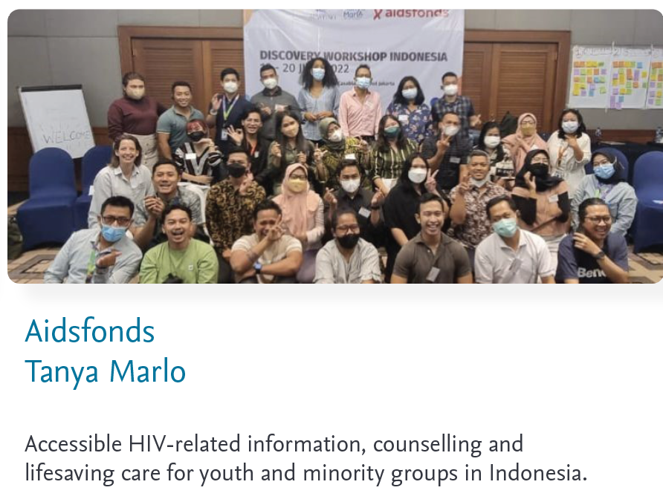
Partnerships | Health emergencies and capacity building

Slide 17
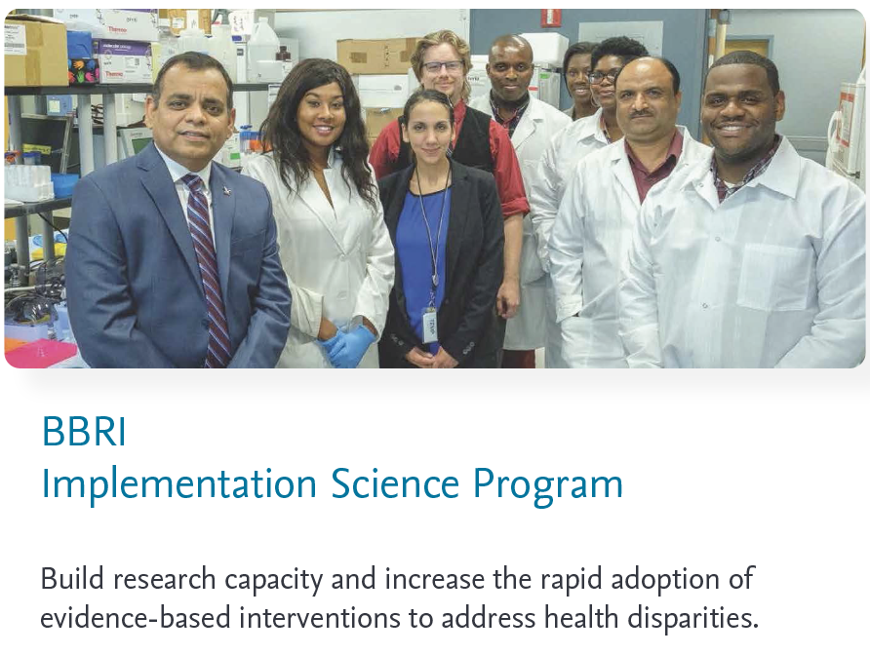
Partnerships | Health equity in the United States

Slide 18
Want to know more?
back to table of contents

Slide 19
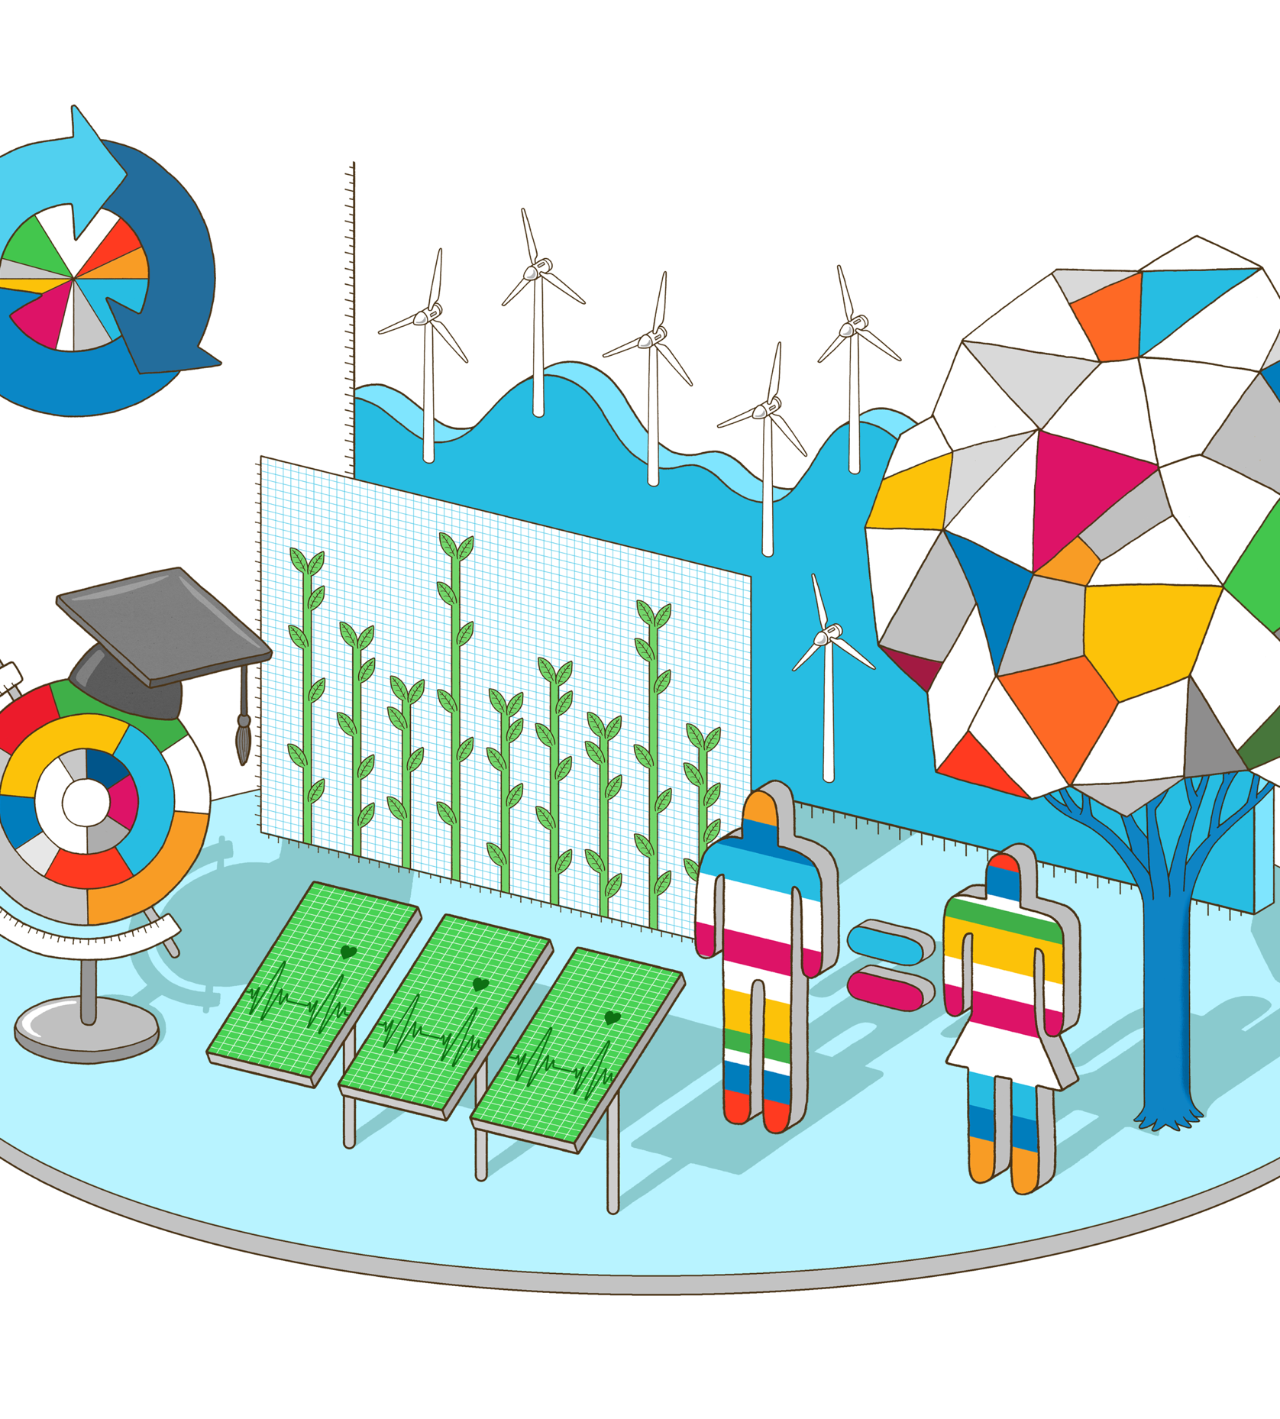
CSR at Elsevier
The Elsevier Foundation is part of Elsevier’s corporate responsibility program, which centers on our unique contributions to sustainable development in health, gender, climate action and reduced inequalities.
Science, research and innovation are fundamental to achieving the sustainable and equitable future envisaged by the UN Sustainable Development Goals. From Elsevier’s publishing portfolios and analytics capabilities, to supporting unique partnerships and working with the global research and health communities, we believe that it is possible to achieve significant progress towards the Goals.

Slide 20
Resources
Resources
Visit our website
Read our last Annual Reports
Follow us on Twitter
Follow us on LinkedIn
Subscribe to our newsletter
Visit the Elsevier Corporate Responsibility & Sustainability page
Visit our website
Read our last Annual Reports
Follow us on Twitter/X
Follow us on LinkedIn

Slide 21
Discover more
elsevierfoundation.org
April 2024

