Slide 1
Corporate Responsibility and the Elsevier Foundation
July 2019
Domiziana Francescon
Program Officer, The Elsevier Foundation

Slide 2
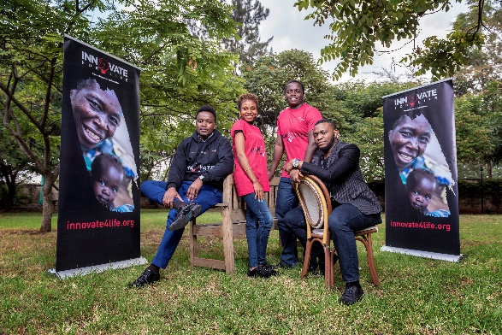

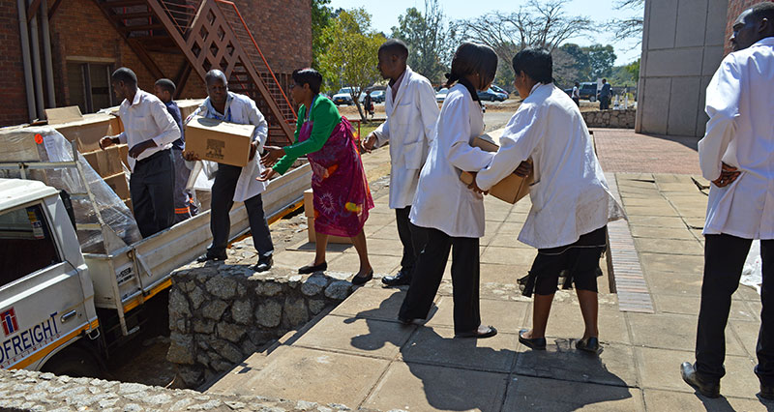
CR at Elsevier
THE ELSEVIER FOUNDATION
SUSTAINABILITY
RESEARCH4LIFE
BOOK DONATIONS
Notes:
The EF sits under the Corporate Responsibility area at Elsevier.

Slide 3
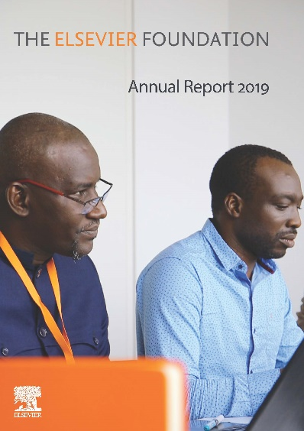
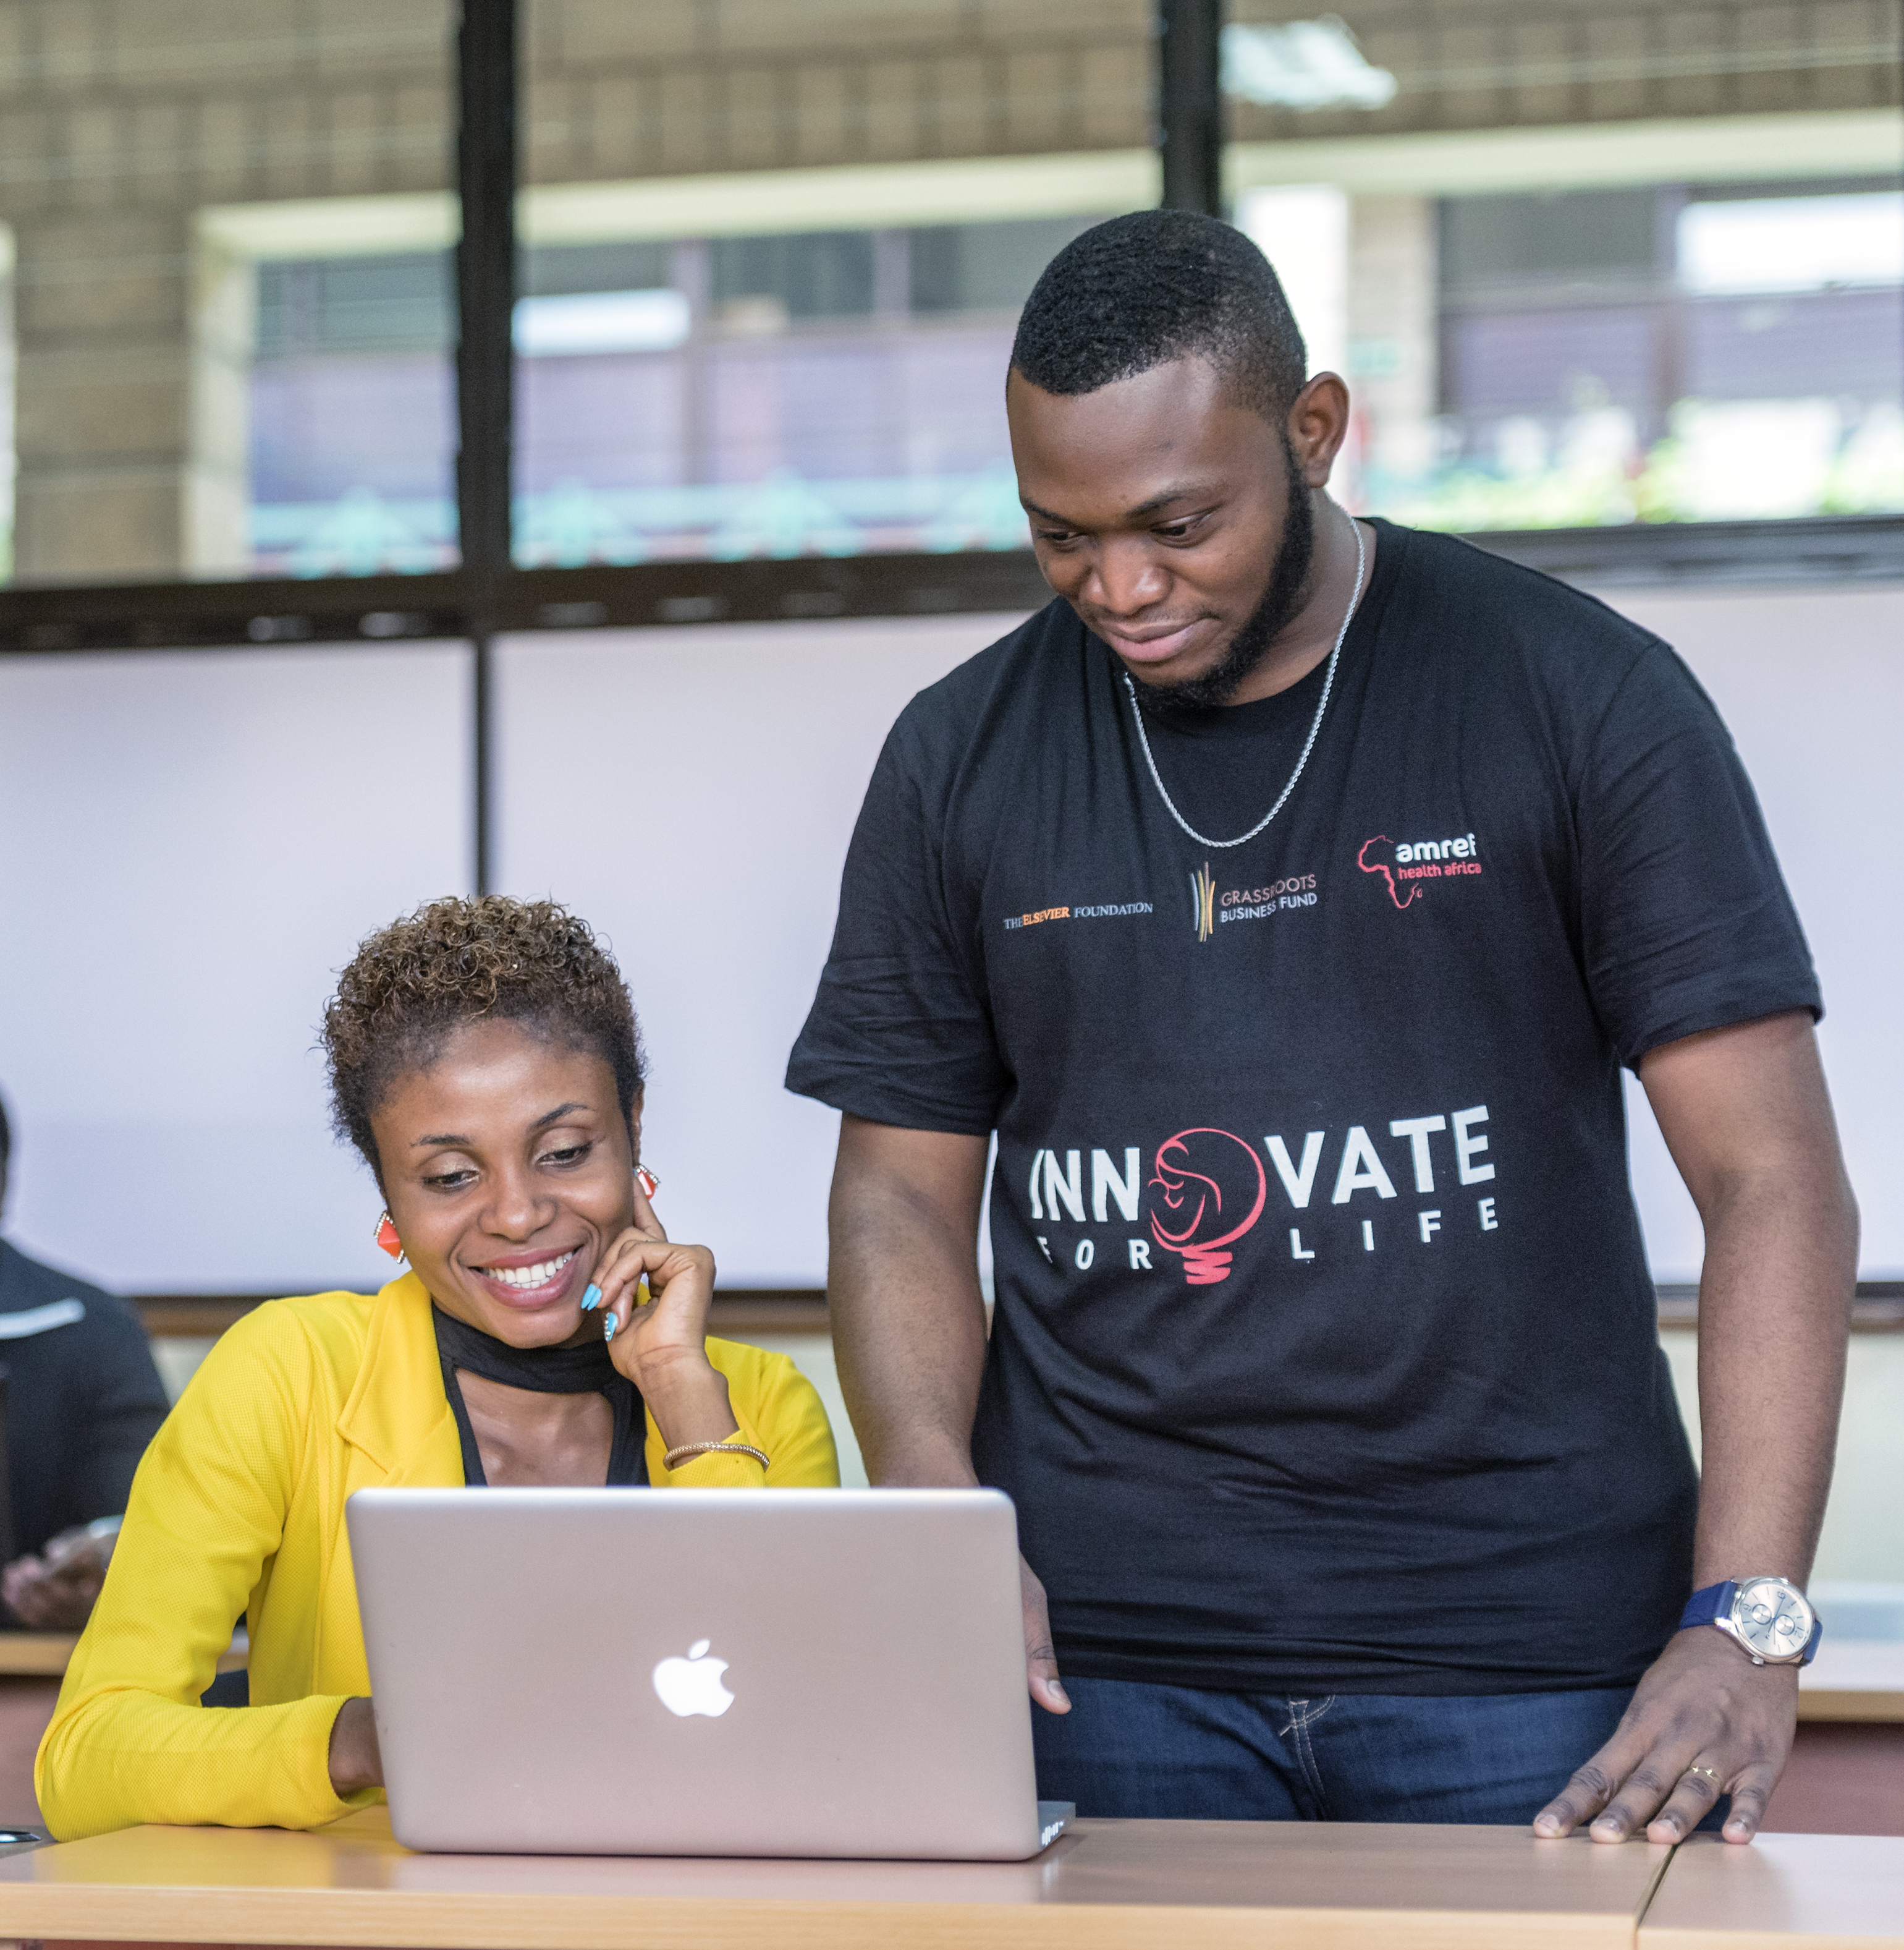
The Elsevier Foundation partnerships
The Elsevier Foundation is a corporate not-for-profit, funded by Elsevier. We provide over $1 million USD a year in grants to knowledge-centered institutions around the world, which address the UN Sustainable Development Goals through tech-enabled innovations in health information, diversity in science and health, research in developing countries. The Elsevier Foundation currently supports 15 partnerships in the following areas:
HEALTH & INNOVATION | DIVERSITY IN STM | RESEARCH IN DEVELOPING COUNTRIES
Support information technologies and organizations engaged in clinical care. | Promote diversity to advance women in science and outreach for underserved youth. | Build stronger research ecosystems in developing countries to bridge the scientific gap.
Notes:
Over the past decade, the Elsevier Foundation has awarded over 100 grants worth millions of dollars to non-profit organizations focusing on the world’s libraries, nurse faculties and women scholars during their early and mid-careers. In 2016, we launched a series of new collaborations that we co-create with our partners.
Link to 2019 Annual Report: https://www.elsevierfoundation.org/multimedia/resources/

Slide 4
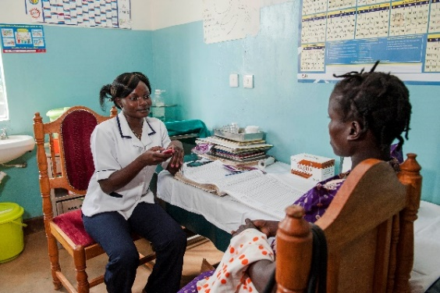
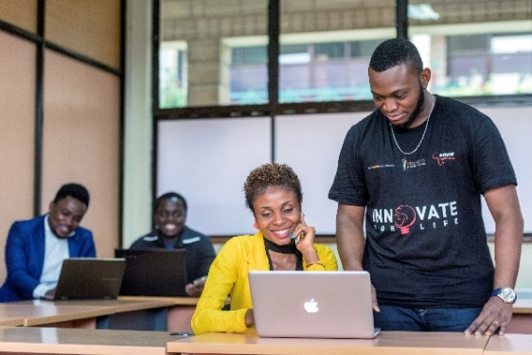
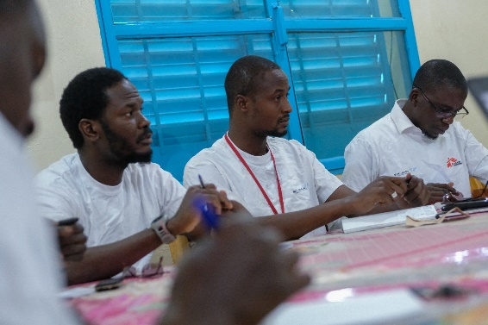
Health & Innovation
Amref: Jibu
Common challenges faced by health workers in developing countries include limited access to education and training. AMREF works with leading doctor and nurse education organization to develop a continuing education nursing app across East Africa.
Amref: Innovate for Life
Accelerator program for African health tech entrepreneurs, bridges gap to international investors with cultural and domain knowledge, strong networks and funding access.
MSF/Epicentre: Niger Research Center
A partnership to build African health capacity and skills, especially in the Niger Research Center, where MSF staff is working to develop a cheaper, heath-resistant vaccine to Rotavirus.

Slide 5
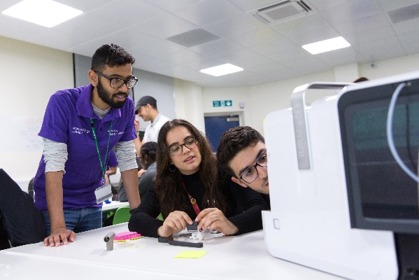
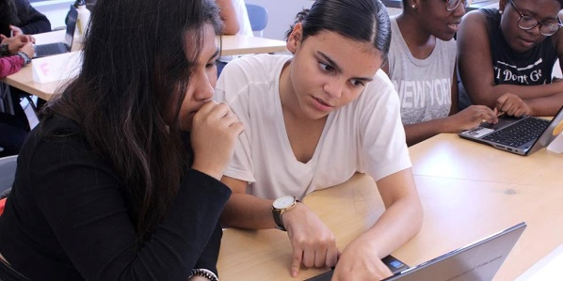
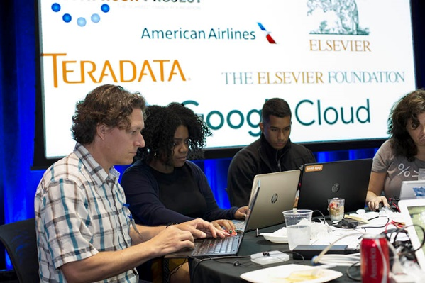
Diversity in STM /1
Imperial College London: White City Maker’s Challenge
“Maker’s Space” for teens from White City to match creativity with cutting-edge science through workshops, afterschool clubs, mentoring and project teams. It seeks to help young people build confidence in their ideas and the skills to turn them into reality, developing hands-on educational outreach.
Girls Inc. of NYC
The Elsevier Foundation Data Analytics Preparatory Program aims to offer girls tangible skills at a lower developmental level to prepare them for the concepts they will encounter in the high school programs.
DataKind: DataDive
High energy 48 hour marathon events: 3 nonprofits working with 80 Elsevier and other big data specialists, developers and designers to use data to solve key problems in those communities. We hosted a DataDive at our London office in July 2019: bit.ly/2GcPeSS

Slide 6
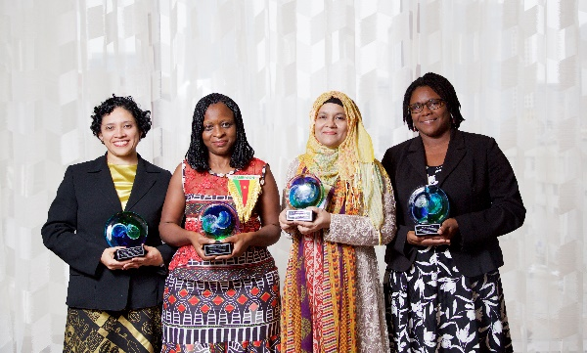
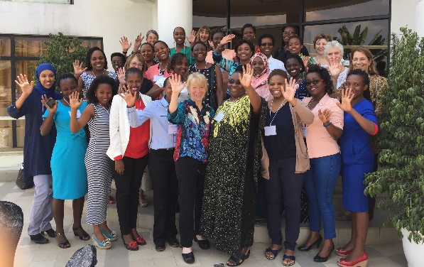
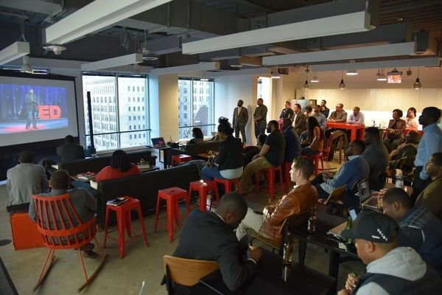
Diversity in STM / 2
OWSD-Elsevier Foundation Awards for Early Career Women Scientists in the Developing World
Since 2012 celebrating women scientists with few role models; longstanding partnership offering visibility and opportunities at the AAAS annual conference.
Water First! Workshops
Leadership and water research workshops for African women scientists with COACh, a university of Oregon initiative. Ghana, September 2019.
The ITEM – Philadelphia
The ITEM (The Inclusive Technology + Entrepreneurship Movement) offers flexible, low cost training and resources to new technologists and entrepreneurs, providing them with marketable and practical tech skills. Its central mission is to ensure everyone can participate in the tech sector.

Slide 7
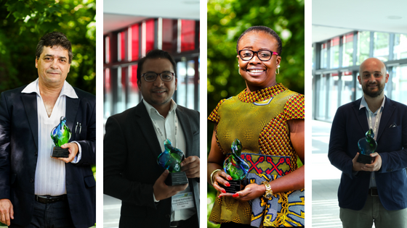
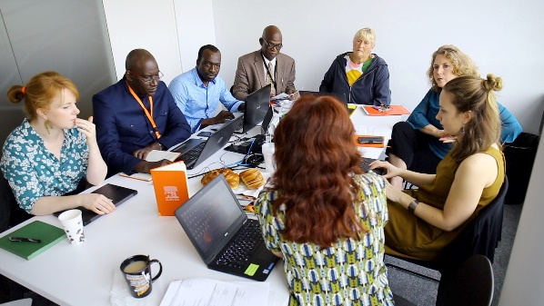
Research in Dev Countries
  The Elsevier Foundation Green & Sustainable Chemistry Challenge
  75K in prizes for projects that use green and sustainable chemistry solutions to tackle SDG challenges, stimulating innovative chemistry research that helps the environment and low-resource communities.
  Research without Borders
We support the African Journal Partnership Program by pairing Elsevier volunteers with African health journals in 10 countries, giving workshops, training and facilitating knowledge exchange.
.

Slide 8

www.elsevierfoundation.org
Twitter: @ElsFoundation

